Slide 1

Geometry
Unit 13, Lesson 4 Partitioning Line Segments Volume 2, pg. 299

Slide 2


Benchmark
MA.912.GR.3.3
Use coordinate geometry to solve mathematical and real-world geometric problems involving lines, circles, triangles, and quadrilaterals.
volume 2, pg. 299

Slide 3
Integrated Mathematical Thinking and Reasoning Standards
MA.K12.MTR.1.1 Actively participate in effortful learning both individually and collectively.
MA.K12.MTR.2.1 Demonstrate understanding by representing problems in multiple ways.
MA.K12.MTR.4.1 Engage in discussions that reflect on the mathematical thinking of self and others.
MA.K12.MTR.5.1 Use patterns and structure to help understand and connect mathematical concepts.
MA.K12.MTR.6.1 Assess the reasonableness of solutions.
volume 2, pg. 299

Slide 4

Learning Target
I can use coordinate geometry to partition a line segment.
volume 2, pg. 299

Slide 5

Warm-Up
volume 2, pg. 300

Slide 6
13.4.1 Warm-Up: Heroic Person
Who do you consider heroic and inspirational?
Why did you pick this person?
volume 2, pg. 300

Slide 7

Exploration
volume 2, pg. 300

Slide 8
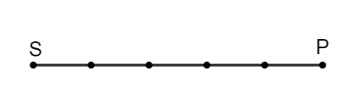
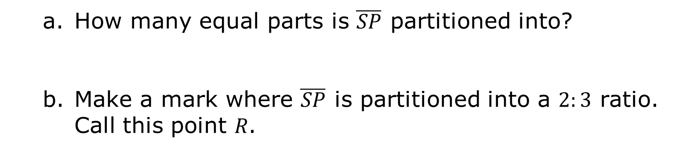
13.4.2 Exploration: Partitioning a Line Segment
Directed line segment $\overline{SP}$ is shown.
How many equal parts is $\overline{SP}$ partitioned into?
Make a mark where $\overline{SP}$ is partitioned into a $2:3$ ratio. Call this point 𝑅.
volume 2, pg. 300

Slide 9
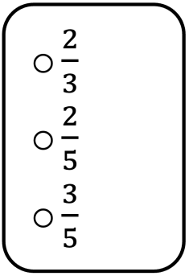

Complete the statement.
Point 𝑅 is of the distance from 𝑆 to 𝑃.
Complete the equation that can be used to find the distance of $\overline{SR}$.
$$SR=_______SP$$
volume 2, pg. 300

Slide 10
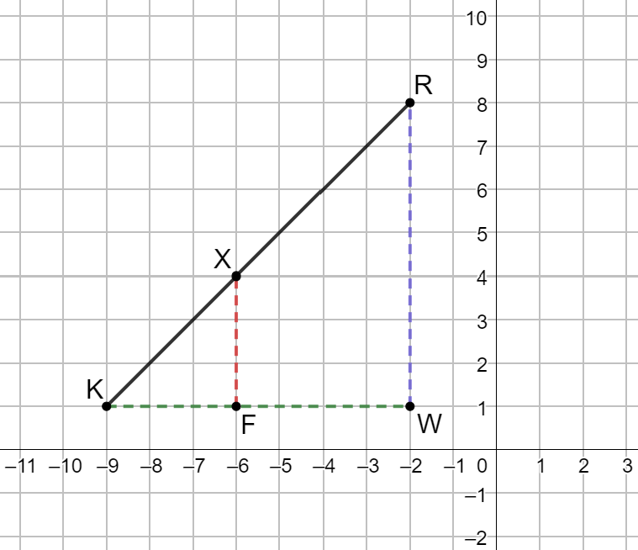
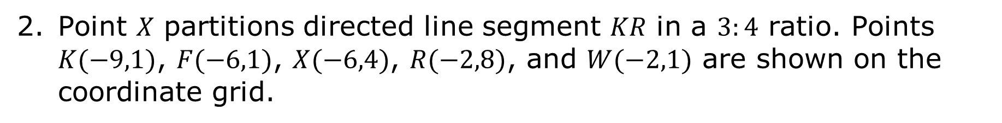
Point 𝑋 partitions directed line segment 𝐾𝑅 in a $3:4$ ratio. Points $K(−9,1)$, $F(−6,1)$, $X(−6,4)$, $R(−2,8)$, and $W(−2,1)$ are shown on the coordinate grid.
volume 2, pg. 301

Slide 11
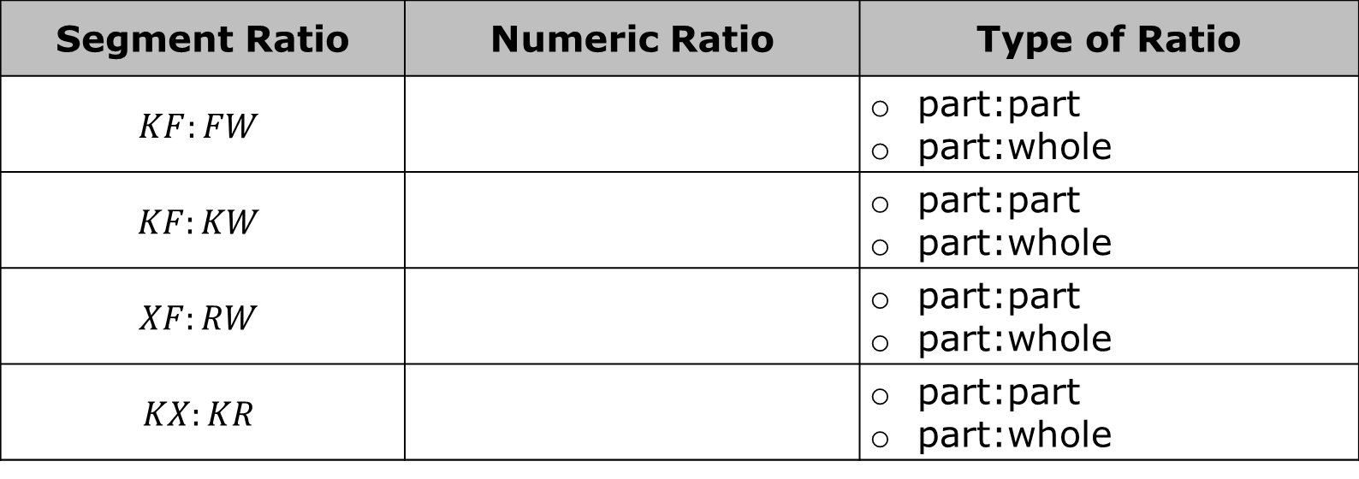
Use the distances to write the numeric ratio for each segment ratio. Then, choose the type of ratio the segment ratio represents.
Segment Ratio | Numeric Ratio | Type of Ratio
$$KF:FW$$ |  | part:part part:whole
$$KF:KW$$ |  | part:part part:whole
$$XF:RW$$ |  | part:part part:whole
$$KX:KR$$ |  | part:part part:whole
What do you notice about the numeric ratios?
volume 2, pg. 301

Slide 12
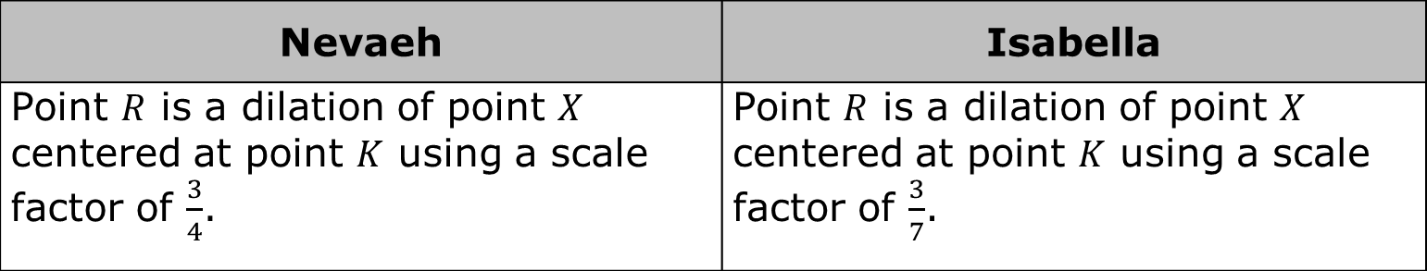
Two students were discussing the directed line segment 𝐾𝑅.
Nevaeh | Isabella
Point $R$ is a dilation of point $X$ centered at point $K$ using a scale factor of $\frac{3}{4}$. | Point $R$ is a dilation of point $X$ centered at point $K$ using a scale factor of $\frac{3}{7}$.
Work with your partner to explain why neither student has the correct scale factor. Include in your explanation what the correct scale factor should be so that the result of dilating at point 𝐾 is point 𝑅.
volume 2, pg. 301

Slide 13
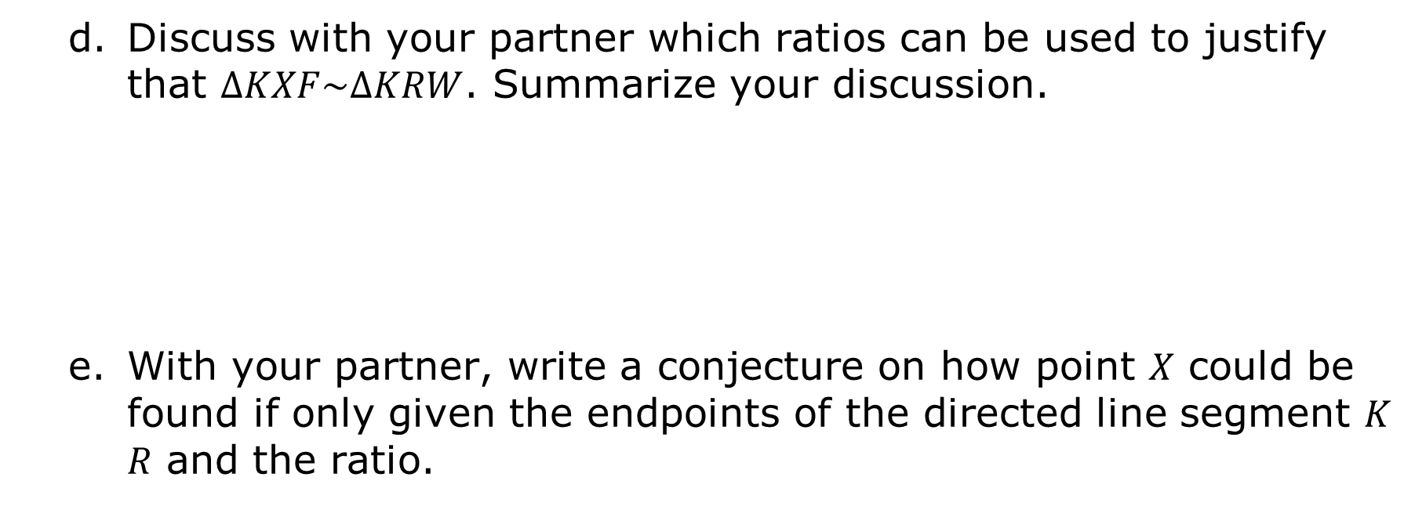
Discuss with your partner which ratios can be used to justify that $∆KXF\sim ∆KRW$. Summarize your discussion.
With your partner, write a conjecture on how point 𝑋 could be found if only given the endpoints of the directed line segment 𝐾𝑅 and the ratio.
volume 2, pg. 301

Slide 14
Ask two other pairs of partners for the conjecture they wrote. Listen to their conjectures and write a summary. You are the only person who should write in the first column of the table. Have the person initial next to your summary stating that your summary was accurate.
Conjecture | Initials
volume 2, pg. 302

Slide 15

Guided Instruction
volume 2, pg. 302

Slide 16
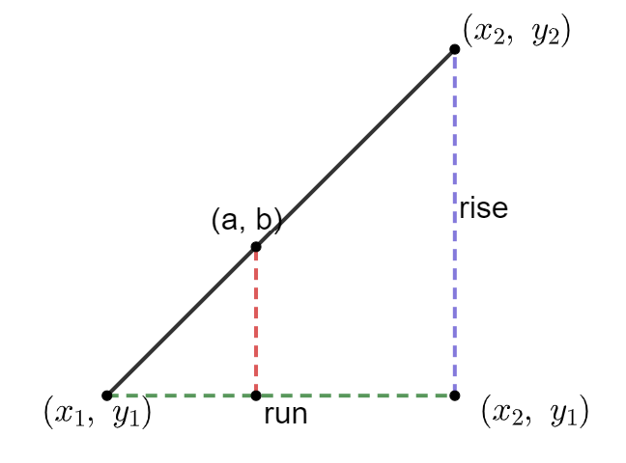
13.4.3 Guided Instruction: Partitioning a Line Segment
Generalize the conjecture in the Exploration if the given ratio is part:whole.
volume 2, pg. 302

Slide 17
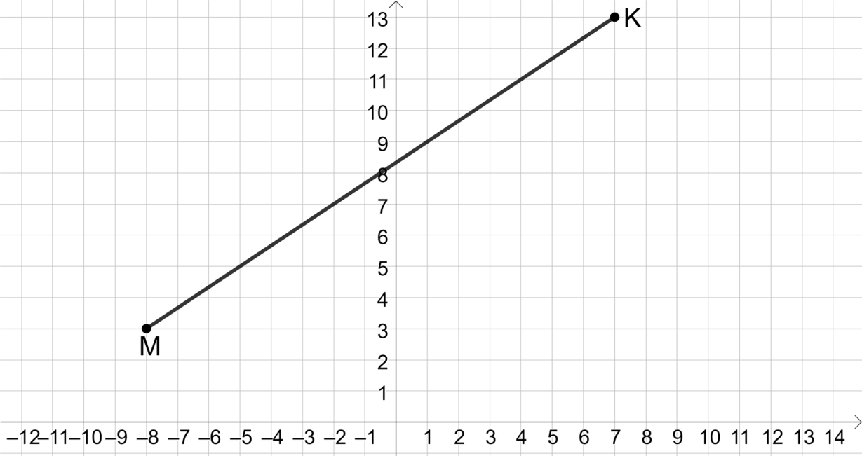
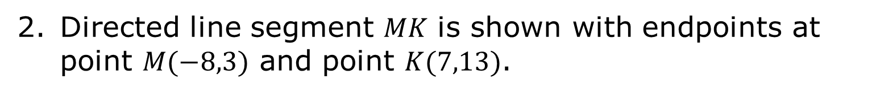
Directed line segment 𝑀𝐾 is shown with endpoints at point $M(−8,3)$ and point $K(7,13)$.
Directed line segment 𝑀𝐾 is partitioned by point 𝐵 in a ratio of $2:3$.
volume 2, pg. 303

Slide 18

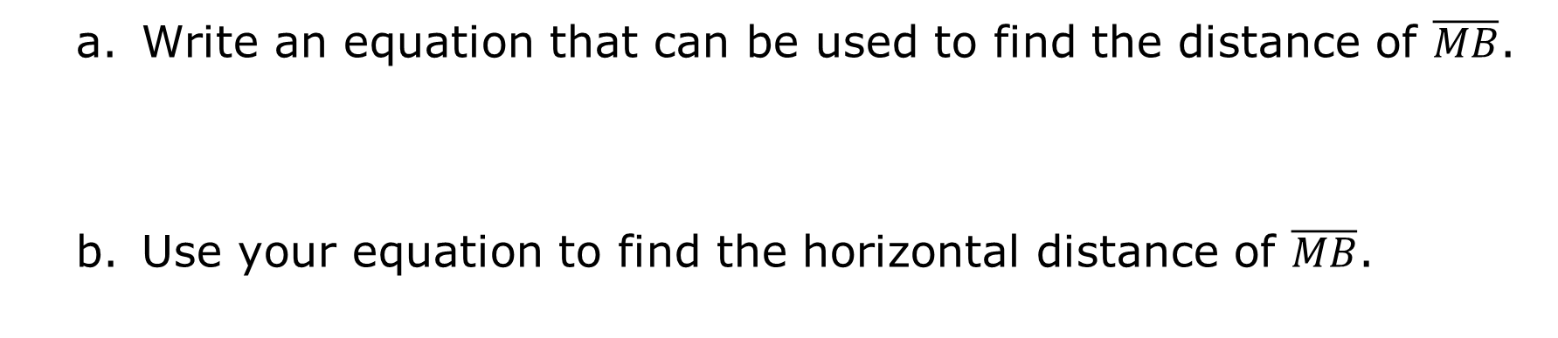
Write an equation that can be used to find the distance of $\overline{MB}$.
Use your equation to find the horizontal distance of $\overline{MB}$.
volume 2, pg. 303

Slide 19
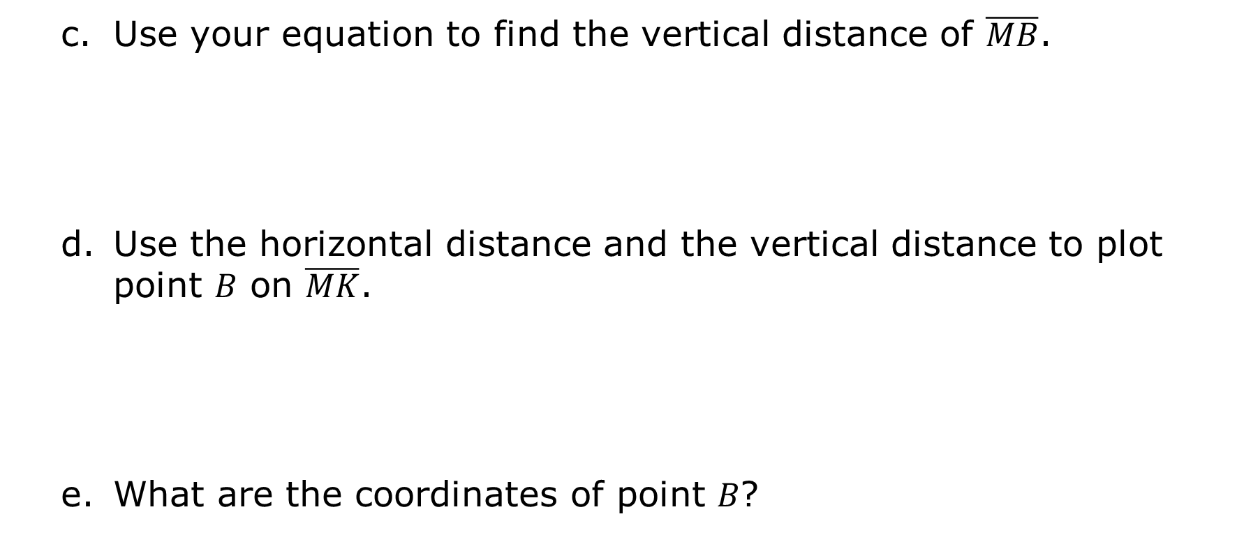
Use your equation to find the vertical distance of $\overline{MB}$.
Use the horizontal distance and the vertical distance to plot point 𝐵 on $\overline{MK}$.
What are the coordinates of point 𝐵?
volume 2, pg. 303

Slide 20
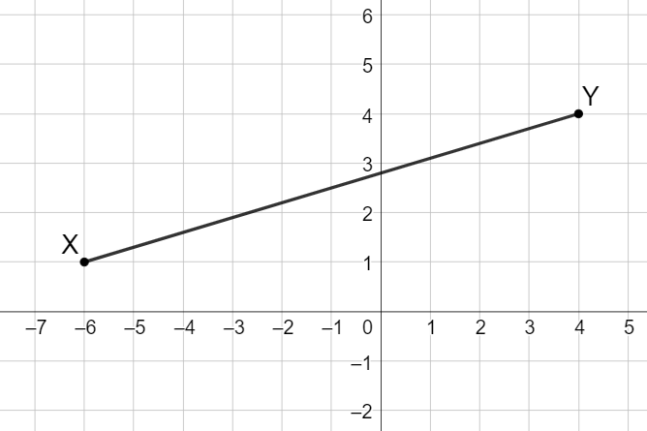
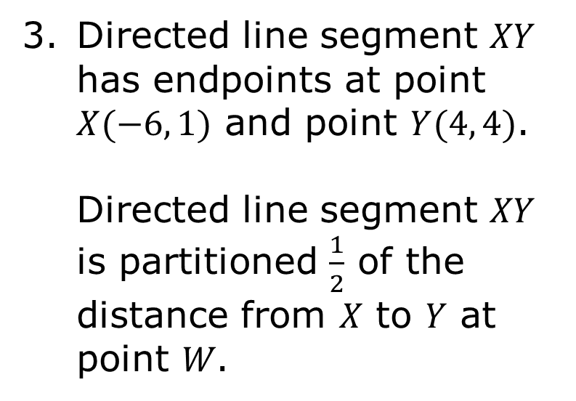
Directed line segment 𝑋𝑌 has endpoints at point $X(−6, 1)$ and point $Y(4, 4)$. Directed line segment 𝑋𝑌 is partitioned $\frac{1}{2}$ of the distance from 𝑋 to 𝑌 at point 𝑊.
volume 2, pg. 304

Slide 21

What is the horizontal distance of $\overline{XW}$?
What is the vertical distance of $\overline{XW}$?
What are the coordinates of point 𝑊?
volume 2, pg. 304

Slide 22

Try It
volume 2, pg. 304

Slide 23
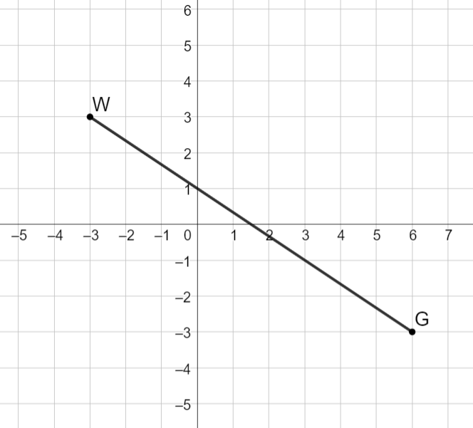
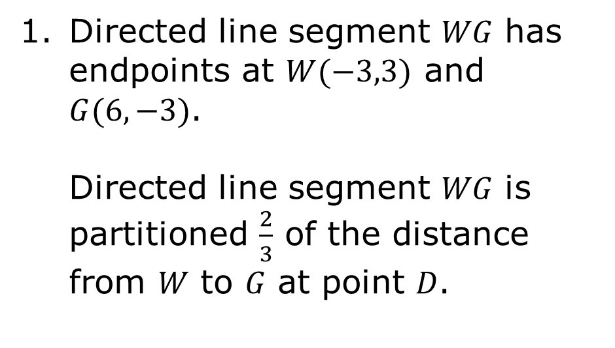
13.4.4 Try It: Partitioning a Line Segment
Directed line segment 𝑊𝐺 has endpoints at $W(−3,3)$ and $G(6,−3)$. Directed line segment 𝑊𝐺 is partitioned $\frac{2}{3}$ of the distance from 𝑊 to 𝐺 at point 𝐷.
volume 2, pg. 304

Slide 24
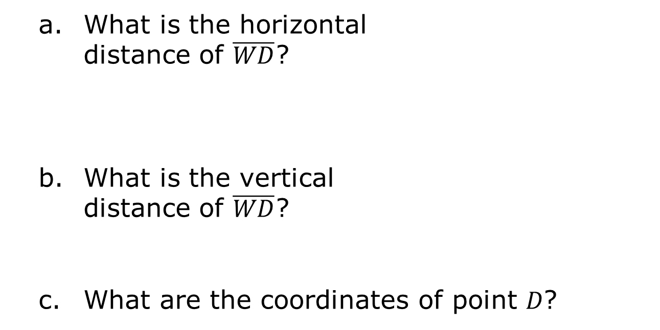
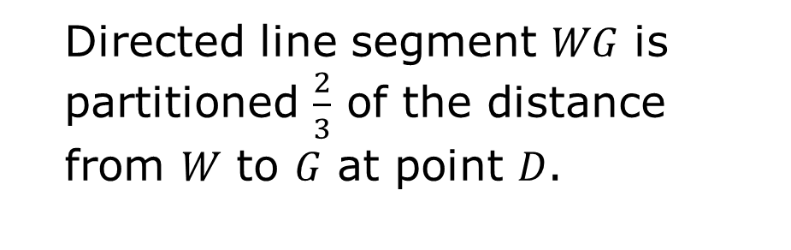
Directed line segment 𝑊𝐺 is partitioned $\frac{2}{3}$ of the distance from 𝑊 to 𝐺 at point 𝐷.
What is the horizontal distance of $\overline{WD}$?
What is the vertical distance of $\overline{WD}$?
What are the coordinates of point 𝐷?
volume 2, pg. 304

Slide 25
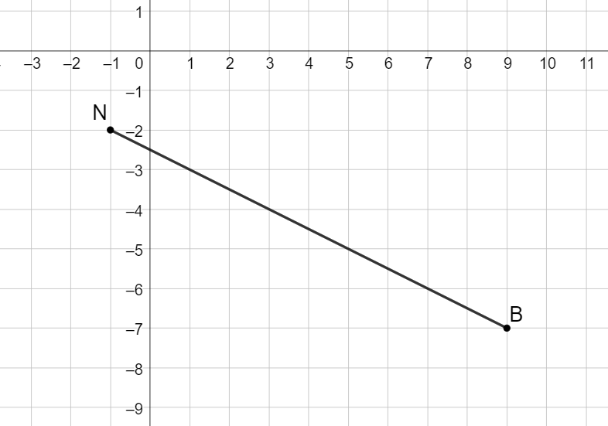
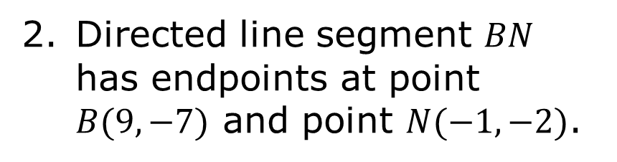
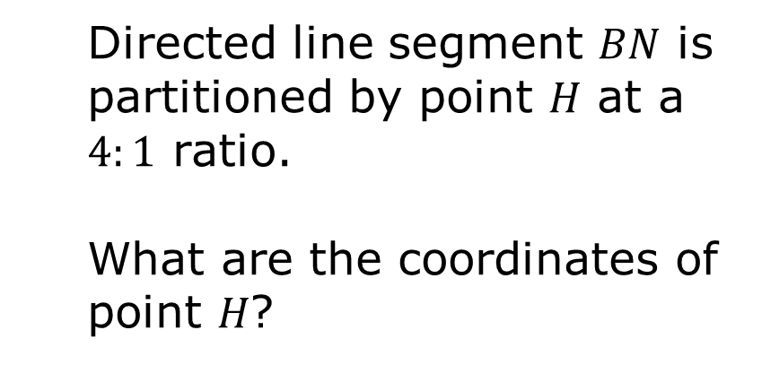
Directed line segment 𝐵𝑁 has endpoints at point $B(9,−7)$ and point $N(−1,−2)$.
Directed line segment 𝐵𝑁 is partitioned by point 𝐻 at a $4:1$ ratio.
What are the coordinates of point 𝐻?
volume 2, pg. 305

Slide 26

Wrap-Up
volume 2, pg. 305

Slide 27
13.4.5 Wrap-Up: Cool Down
Write a summary of what you learned in this lesson.
volume 2, pg. 305

